Slide 1
Lecture 12 Sept. 30th ,2019
Thank you for independent study of last Friday’s concepts.
Much of the content was practiced in Thursday’s lab. Thank you for hard work there as well! I think several of you thought about Mendel’s actual process and the tedium/boredom he may have experienced.
Hopefully he had good helpers like you did!
Be sure to also look up Barbara McClintock---why?

Slide 2
Be able to explain---at the level of a molecule, why some flowers of the garden peas are white, while others are purple.
Ditto—at the level of the molecule, why are some peas smooth, while others are wrinkled.

Slide 3
Try it yourself
Design a different dihybrid cross.
Choose proper true breeding parents
Assign symbols accordingly
Show gametes formed by the Parents, then by the F1
Show a punnett square with all combinations of genotypes in the F2 generation. Show corresponding phenotypes.
See if you note a 9:3:3:1 F2 generation ratio.

Slide 4
Try it!
Show how you would set up a test cross for each of the genotypes showing yellow/round peas.
Prove each genotype would give different outcomes in a test cross.
Draw it! Sketch it! Use punnett squares! Possible pop quiz question for the future!

Slide 5
Back to dihybrid cross…
When independent assortment is in operation, dihybrid crosses show a consistent
9:3:3:1 F2 ratio
e.g. in our example: 9/16 yellow round
3/16 yellow wrinkled
3/16 green round
1/16 green wrinkled
F2 ratio

Slide 6
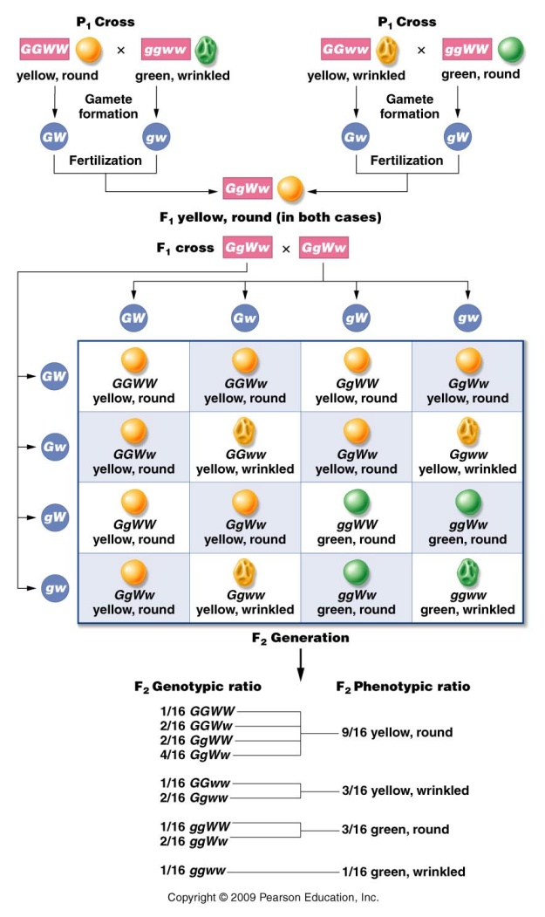
How is this outcome related to the monohybrid F2 ratios?...
Each trait is inherited exactly as it is in a monohybrid cross.
Consider color
and shape separately
(on board)

Slide 7
Start thinking of F2 ratios as expectations/probabilities/expected outcomes
Rule for combining probabilities…
When 2 independent events occur at the same time, the combined probability is the product of each individual probability. PRODUCT RULE
What is the probability of having F2 offspring showing both the yellow and round phenotypes?
(¾ yellow ) (¾ round) 9/16 yellow and round

Slide 8
Extending into tri-hybrid (3-factor) crosses…AND BEYOND!
Start to take some shortcuts, being consistent with the rules of Mendelian crosses
P X P (true-breeding parents)
F1 heterozygote (assume independent assortment occurs)
F2 (analyze ratios)

Slide 9
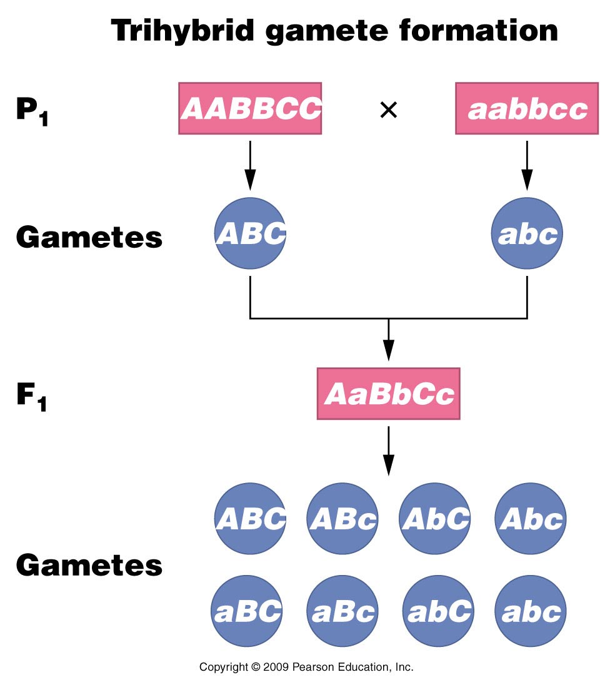
F1 heterozygote—3 unlike pairs of unit factors
Figure 3.9
Notes:
Figure 3-9 Formation of P¹ and F¹ gametes in a trihybrid cross.

Slide 10
How many types of gametes?
2^{n} where n= # of unlike unit factor pairs in the F1 heterozygote.
3-factor cross n=3 so…8 unique types of gametes
Independent assortment!!

Slide 11
How big is your punnett square?
8 types of gametes
8X8=64 entries!

Slide 12
How many different genotypes?
Each factor has 3 possible genotypes.
AA, Aa, aa
BB, Bb, bb
CC, Cc, cc
One possible combo: AA bb Cc
Consider all possible combos…
3^{n}, where n is the # of unlike unit factors. For n=3; 27 unique genotypes.

Slide 13
How many different phenotypes?
Since there are only 2 phenotypes (dominant and recessive)
2³ = 8 different phenotype combinations.

Slide 14
Summarizing
In a 3-point/tri hybrid cross:
8 unique gametes (64-box Punnett square)
27 unique genotypes
8 unique phenotypes
(Table 3.1)

Slide 15
Table 3.1
Notes:
Table 3-1 Simple Mathematical Rules Useful in Working Genetics Problems

Slide 16
Back to the product rule…
You can determine the probability of any genotype or phenotype easily using a tool called a branch/forked line diagram.
I find it easier to use than a punnett square when considering many factors at once.

Slide 17
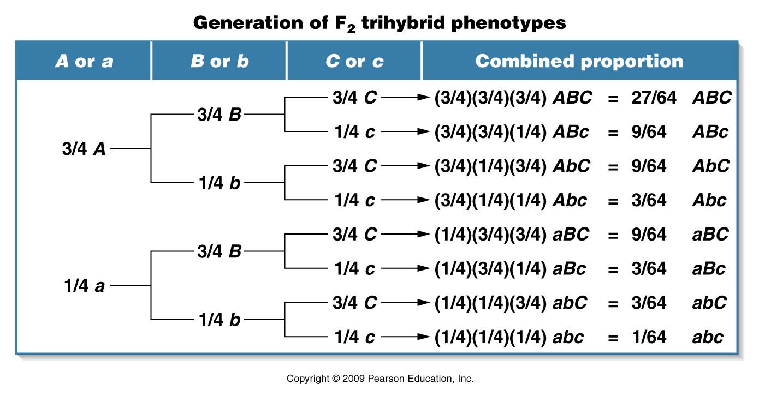
Practice!!! Make it a 4-factor cross--add one more trait—D or d
yellow
ROUND
green
Tall
yellow
WRINKLED
green
yellow
ROUND
green
dwarf
yellow
WRINKLED
green
This table expresses phenotypes. You could also determine probabilities of genotypes (AabbCC—which would give phenotype AbC.)
Figure 3.10
Notes:
Figure 3-10 The generation of the F2 trihybrid ratio using the forked-line, or branch diagram method, which is based on the expected probability of occurrence of each phenotype.

Slide 18
Test yourself!
In a 5-point cross, what ratio of F2 offspring should show all dominant traits?
All recessive traits?
This genotype? AAbbCcDDEe—What is the probability that the F2 offspring will have this genotype? (Go back to the 1:2:1 genotype ratio)

Slide 19
Let’s return to probabilities…
Mendel’s observations allow us to predict the outcome of other experiments
Cross of violet (dominant) X white (recessive) flowering plants
F1? 100% violet flowering plants
What would you predict to find in F2 plants?

Slide 20
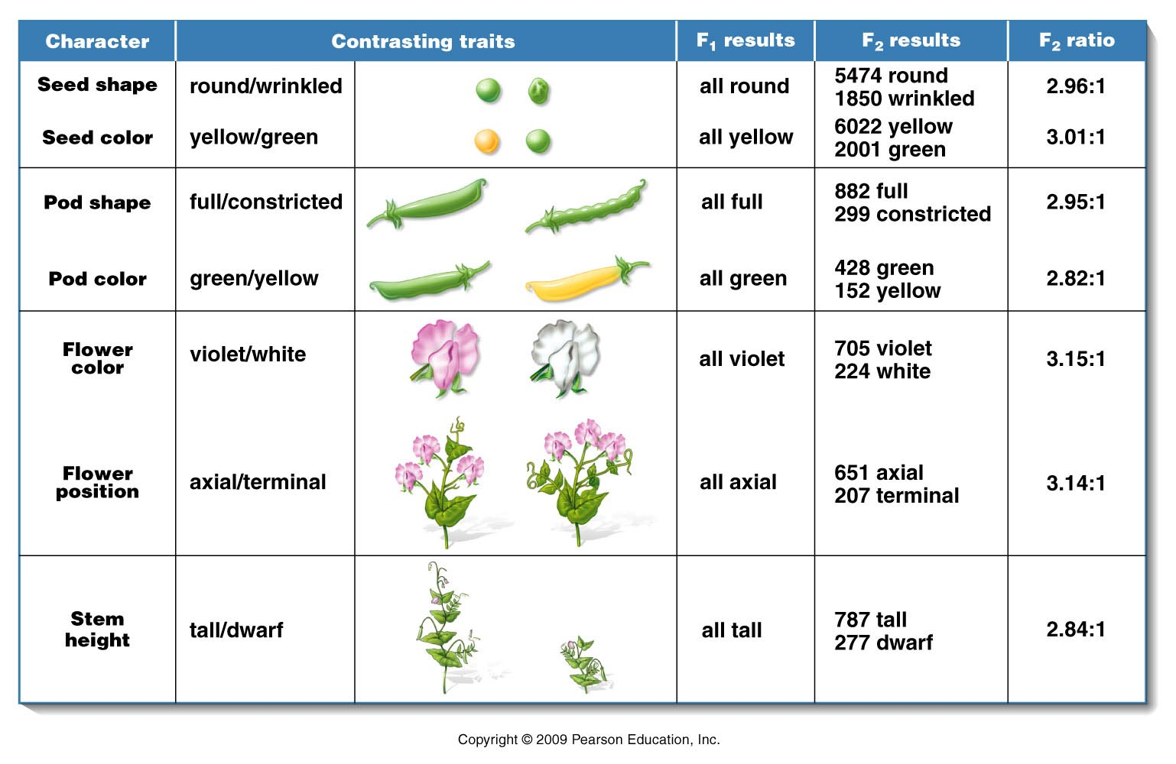
F2 prediction/probabilities?
¾ violet: ¼ white
Mendel observed 929 plants: 705 violet/224 white

Slide 21
What did you expect theoretically?
¾ (929) violet=696.75
¼ (929) white=232.25
…Why this deviation/difference from the expected:
705 violet/224 white?
…Is it reasonable deviation?

Slide 22
First…where could the deviation come from?
F2 offspring were the product of:
1. gamete formation (random alignment of homologs at metphase I)
2. random union of gametes
Is there any opportunity for chance to alter expected outcomes here?...

Slide 23
Biology is full of random fluctuations/chance deviation
Can use statistical tests to evaluate whether data fits an expectation by evaluating the influence of chance on the data.
One such test called the Chi-Square test
Like all statistical tests, it allows us to test a general statement called the Null Hypothesis (H₀)

Slide 24
The 13 Scwandt children---ages 2-25.

Slide 25
What unlikely event happened here? Why is it possible?

Slide 26
Null Hypothesis (H₀)
“There is no real difference between the measured values/ratio etc. and the expected values/ratio etc. Any apparent difference can be attributed to chance alone.”
Memorize and understand this!

Slide 27
It’s the ultimate humble hypothesis!
Scientists/analysts don’t want to be mislead. By starting with the possibility of “just chance” as an explanation/hypothesis, they don’t waste time pursuing data that doesn’t quite fit expectations.
But when statistics tell us to reject this hypothesis, we may have something new to discover/explain.

Slide 28
Chi-square
Chi-square (X²) analysis helps us decide whether deviation in expected and observed values are reasonably attributed to chance.
Or…if the deviation is so great that the reason is something more interesting than chance.

Slide 29
In X² analysis, one of two results are possible.
Reject the null hypothesis
Indicates the deviation in expected and observed values is too great to be attributed to chance alone (look for alternative explanations)
2. Fail to reject the null hypothesis
Indicates the deviation in expected and observed values can reasonably be attributed to chance alone. If you have an expected outcome, your data shows reasonable difference from theoretical outcomes.

Slide 30
X² analysis
X²= Ε (o-e)²
e
X²= the sum of the difference of observed and expected values, squared, divided by the expected value.
Let’s plug in Mendel’s data from the Tall X dwarf cross on the board (figure 3.1)

Slide 31
Figure 3.1
Notes:
Figure 3-1 A summary of the seven pairs of contrasting traits and the results of Mendel’s seven monohybrid crosses of the garden pea (Pisum sativum). In each case, pollen derived from plants exhibiting one trait was used to fertilize the ova of plants exhibiting the other trait. In the F¹ generation, one of the two traits (dominant) was exhibited by all plants. The contrasting trait (recessive) then reappeared in approximately one-fourth of the F² plants.

Slide 32
X²⁼ Tall (0.15) + dwarf (0.45) = 0.60
X²⁼ 0.60

Slide 33
Next step…
Determine the degrees of freedom for you data. (How many categories can contribute to the deviation in the observed and expected values?).
df= n-1, where n is the number of categories you have analyzed. In our example monohybrid crosses give 2 kinds of offspring (tall and dwarf) n=2 ; df=1

Slide 34
Next step…
Determine a probability (p value) from a graph or table.
X² values in blue area
P-values (range) at top
df on left side

Slide 35
What does a p value mean?
A p-value is the probability that we would see as much, or more difference in observed and expected values due to chance alone--- in repeated experiments.
e.g. p=0.90 (high p-value) ---in repeated experiments we could expect this much, or more deviation in observed and expected values 90% of the time due to chance alone…
p= 0.01 (low p-value) in repeated experiments we could expect this much, or more deviation in observed and expected values 1% of the time due to chance alone…

Slide 36
In statistics, we often use an arbitrary probability cut-off of 0.05 to decide whether to reject H₀
P< 0.05 means that the observed deviation in observed and expected results would happen less than 5% of the time by chance alone.
In this case we would reject H₀
p>0.05 means that the observed deviation in observed and expected results would happen at least 5% (5% or more) of the time by chance alone.
In this case we would fail to reject H₀

Slide 37
It’s a pretty humble cutoff…
When we reject H₀ we say the data shows a large enough deviation to consider an alternative explanation. (not chance deviation)
When we fail to reject H₀ we say that the deviation in the data can reasonably be attributed to chance.

Slide 38
Practice!!
Try chi-square analysis on any/all of the monohybrid crosses in figure 3.1
(As you glance at the ratios---what do you expect the outcome will be?...)
It is essential to know what the theoretical expectations are…What do you expect in a dihybird cross? What do you expect in a test cross?

Slide 39
Try Chi Square analyisis on the Scwandt family.
What are the observed and expected values?
What X² value do you calculate?
What is the corresponding P value?
Do you reject or fail to reject the null hypothesis?

Slide 40
Some general observations in Chi-Square analysis
When o and e values are very close, X² is small and p value is high. (fail to reject H₀)
More categories of data result in higher df. How does that affect P value?
Allows us to have more deviation (higher X²) for the
p> 0.05 cut-off. (see table)
df=1 X²=3.814 p> 0.05
df=3 X²=7.875 p> 0.05
df=1 X² >3.841 p> 0.05
Df=3 X² >7.875 p> 0.05

Slide 41
Can we lessen the influence of chance on our experiments?
Toss a coin 5X 5 heads: 0 tails OK? Sure!
Toss a coin 500X 500 heads:0 tails NO!
(Should never see this!)
Why….? Increasing the sample size decreases the chance fluctuation in the outcome. (This is all increasing sample size does!)

Slide 42
Again….what happens when p<0.05?
Reject the null hypothesis. You should be interested!!
After all you started with a pretty boring expectation…rejecting H₀ means something unexpected occurred according to your data.

Slide 43
But first…Pose the question.
Is the sample size small? Perhaps our rejection of H₀ is due to a small sample size. (like flipping a coin only 5 times)
Increase the sample size and test again? If P value increases, may have had too small a sample in the beginning.
If increasing sample size does not increase p value…the deviation is likely due to something other than chance!

Slide 44
What then?...Form an alternative hypothesis…
How…?
By examining the data closely.
500 heads: 0 tails Say more than “something unexpected happened”.
Hypothesis…The coin is a trick coin with 2 heads. This is great, since we can test this hypothesis easily.
In the next chapter we will see that Mendel’s ideas must be extended to explain inheritance of specific traits. Data might not fit the observations made by Mendel on peas…Be careful observers.

